Slide 1
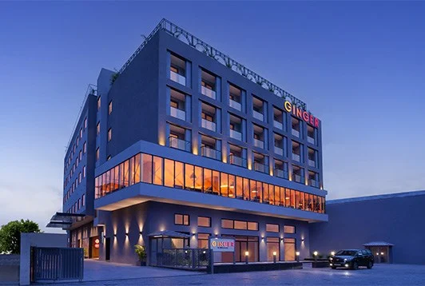
Hotel Booking Analysis
Report Prepared & Presented By :
Akash Pramod Patil
Ashutosh Patil

Slide 2
Guided by : Abhishek Wavhal

Slide 3
Summary of Report
01
This Dataset had two hotels City Hotel and Resort Hotel.
03
We will do the data cleaning as to fill any null values and delete any duplicated values and after that we have to do data wrangling.
02
The data provided was for 3 years 2015 , 2016 and 2017. We also have the revenue and booking details with number of days of stay and booking cancellation, total number of guests including children
04
we will do our analysis for both city and resort as individual businesses and in comparison to one another. We will also take help of charts for better analysis..

Slide 4

Data Cleaning Process
There are total 1,19,390 Rows.
Removed errors from entire data set.
Removed duplicate data.
We have removed data which has cancelled booking.
We had deleted column name arrival date week number and Company.
Merge Column where arrival_Date_Year, Arrival_Datem_Month and Arrival_Date is there in one column name Date.
Added column of sum of total days stay in weekend and weekdays.
Added column of sum of total guest stay including Adults, Children, babies.
After the Cleaning Process we have 85,00 rows data.

Slide 5

Lets Start Analysis

Slide 6

Here We have 2 Types of Data that's Why We Used Pie Chart in this Question. The Booking Ratio of Hotels is as follows:- A. Resort Hotel : 33,970 (38.87%) B. City Hotel : 52,430 (61.13%)

Slide 7
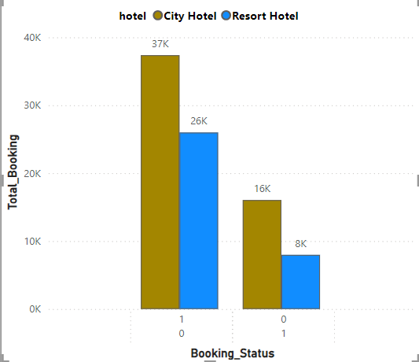
Booking Status
The Cancellation and Confirmation Ratio of Hotels is as follows:-
Cancellation
Resort Hotel : 7,969
City Hotel : 16,031
Confirmation
Resort hotel : 25,982
City Hotel : 37,238

Slide 8
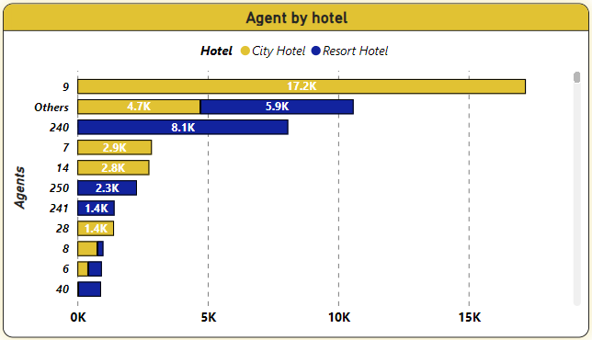
Analysis of Booking Activities by Travel Agents
The chart shows bookings made by various travel agents.
After looking at it, we can see that Agent ID-9 has made the most bookings. You can tell because the bar for Agent ID-9 is the tallest, meaning they've made more bookings than anyone else.

Slide 9
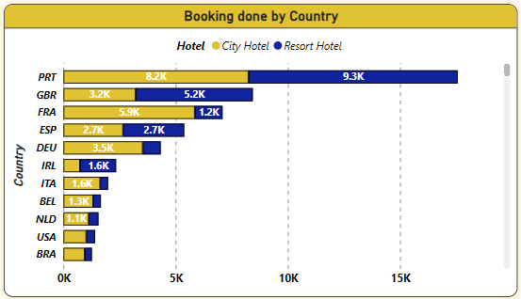
Top Booking Destination Among Global Countries
We've looked at data from countries all around the world and singled out the top 10.
Among them, Portugal (PRT) stands out with the highest number of bookings at 27,449, making it the most popular destination in this dataset.

Slide 10
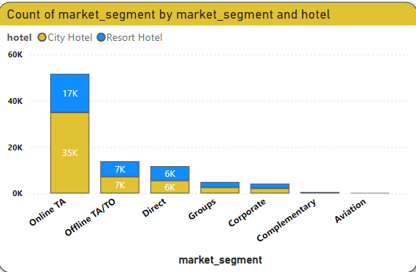
Booking Trends
Our analysis reveals that the majority of customers are booking through online travel agencies (OTA).

Slide 11
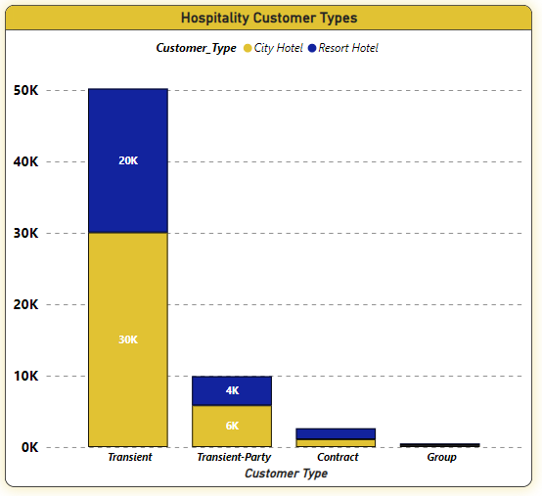
Customer Types
In this section, we have identified the types of customers, highlighting that transient customers account for the highest number of bookings

Slide 12
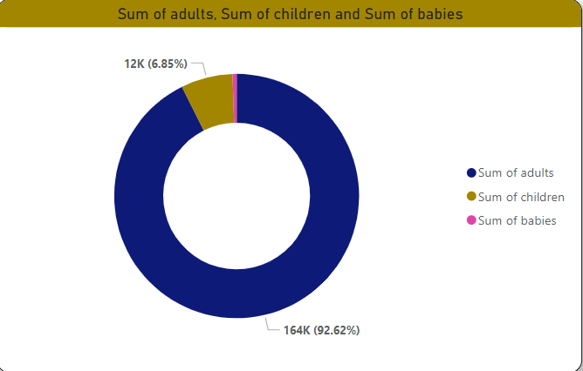
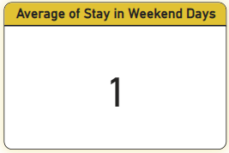
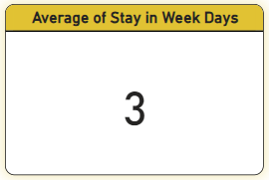
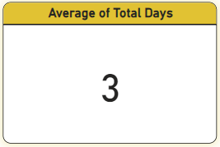
Analyzing Guest Numbers and Duration of Stay
The data analysis shows the average length of weekend stays, providing insight into customer behaviour and enabling businesses to tailor their services accordingly.
The data analysis reveals the average length of stays during weekdays, providing insights into customer behaviour and informing strategies to optimize services and occupancy during the week.
A total of 116870 adults, 7587 children, and data for 768 babies indicate bookings at the hotels.
In this context, we have utilized a donut chart to represent data in three categories.
The data analysis provides the average total length of guest stays, offering insights into guest behaviour and informing strategies to enhance guest experiences and operational efficiency.

Slide 13
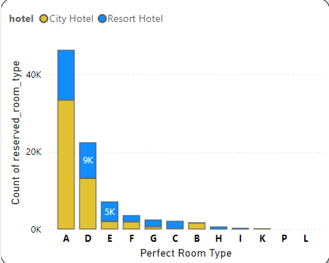
Room Type Preference Analysis:
Our analysis shows that customers prefer Room Types A and D the most when booking.
Despite having nine room options, these two are the top choices.
We've used a column chart to visually present this data, making it easy to see which room types are most popular.
This insight can help us make informed decisions about managing inventory and marketing strategies.

Slide 14
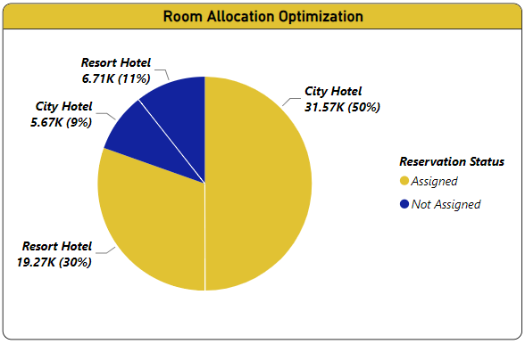
Room Allocation Optimization
The chart underscores that 20% of customers are unable to secure their preferred room, while 80% successfully obtain their desired choice.
This distribution emphasizes the significance of refining room allocation strategies to ensure a higher rate of satisfaction among guests.

Slide 15
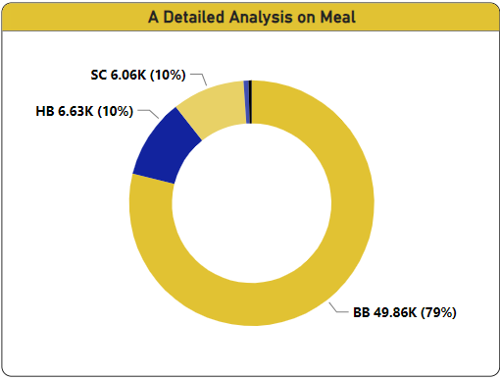
Meal Preference Analysis
We've identified the meal preferences of customers during the booking process, with the majority opting for Bed & Breakfast (BB) at 79%, followed by Self Catering (SC) and Half Board (HB) at 10% each.
The remaining preferences are categorized under two other meal types. To represent this distribution visually, we've selected a Donut Chart..

Slide 16
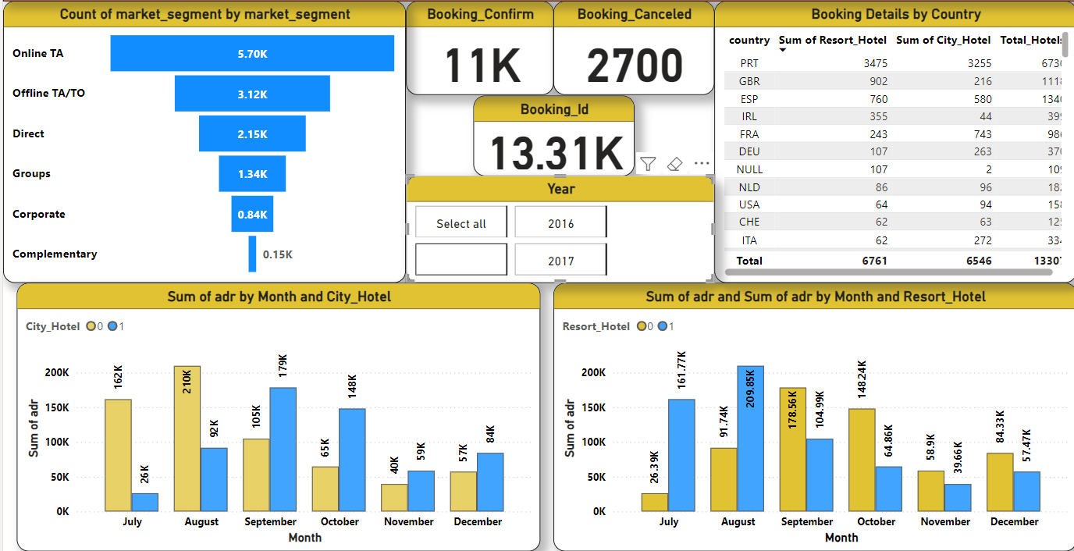
Revenue Analysis Report of Year 2015

Slide 17
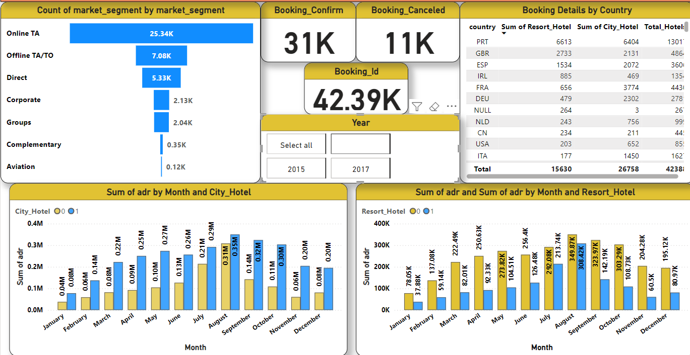
Revenue Analysis Report of Year 2016

Slide 18
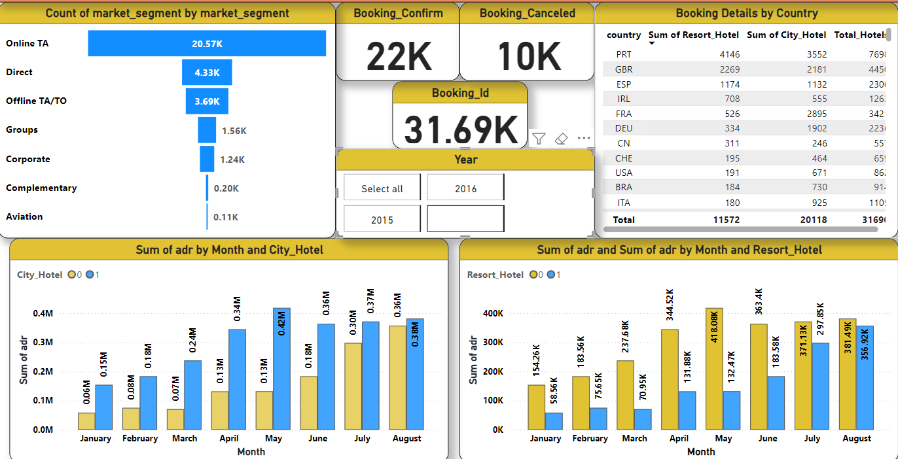
Revenue Analysis Report of Year 2017

Slide 19
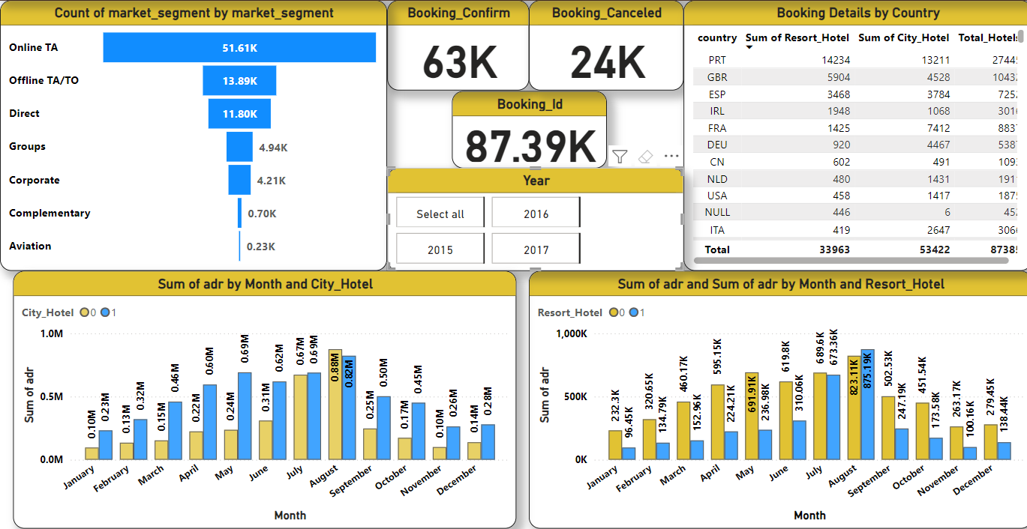
Revenue Analysis Report of Year 2015,16 and 17

Slide 20
Suggestion and Solution to Business Objective
A resort hotel should prioritize attention to all essential amenities to attract customers and increase the average daily rate. By focusing on providing a comprehensive range of services and facilities, the hotel can enhance its appeal to guests seeking a complete and enjoyable experience.
After Analyzing the data we are able to understand that the maximum bookings are done for type A and D hence the management can either reduce type of rooms or get more amenities in other types. They can also give discounts.
We have concluded that the 20% of customers did not get their preferred room so management should ensure that the room type booked by the customers is the one provided to them. If the management fails to do so, it may have an impact on their revenue
Focus marketing on Room Types A and D, allocate more inventory to them, and analyze reasons for their popularity to improve other options.

Slide 21
Conclusion
In this project, we observed that city hotels are the primary choice of the customers
Bookings through agents are maximum predominant, and guests mainly hail from Portugal, the United Kingdom, France, and Spain.
A and D room type are most preferred room with BB-type food.
As bookings and guest arrivals increase, the Average Daily Rate (ADR) also rises, indicating a positive correlation between ADR and the number of guests.
This suggests that ADR is proportional to the number of people, highlighting the financial growth potential as occupancy rates increase

Slide 22
Thank You

